Slide 1
Fraudulent Claim Detection
By Rajagopal G.V

Slide 2
Problem Statement
Every year, thousands of claims are processed by Global Insure, a top
insurance provider. But a sizable portion of these assertions are later
found to be false, causing large financial losses.
Manual inspections are the company's current method of detecting false
claims, and they are ineffective and time-consuming. Fraudulent claims
are frequently discovered after the corporation has already made sizable
payouts, which is too late in the process. Using data-driven insights,
Global Insure hopes to enhance its fraud detection procedure by early
in the approval process, classifying claims as either legitimate or
fraudulent. In addition to minimizing monetary losses, this would streamline
the claims processing procedure as a whole.

Slide 3
Business Objective
How can we analyse historical claim data to detect patterns that indicate fraudulent claims?
Which features are most predictive of fraudulent behaviour?
Can we predict the likelihood of fraud for an incoming claim, based on past data?
What insights can be drawn from the model that can help in improving the fraud detection process?

Slide 4
Features of the Dataset
1000 Datapoints
40 features:
One Target Variable: Fraud_Reported
Yes – 247 Count
No – 753 Count
Target variable demonstrates High Class Imbalance. Important to take care of this during modelling.
Dataset split into Train and Test set for modelling purpose. Train set had 800 datapoints. Test set had 200 datapoints.

Slide 5
Evaluation Metric
The evaluation metric for this project is precision and recall and ROC Score.
For business, it is important to identify false positives and true negatives, so recall is to be given more importance.

Slide 6
Data Cleaning and Preprocessing

Slide 7
Changing datatypes and Dropping columns with Unique Values
Needed to change dtype of certain columns from numerical to categorical as they were categorical features by nature:
Number of Vehicles Involved
Number of Bodily Injuries
Number of Witnesses
Decided to drop 5 columns as had too many unique values, did not give any useful insights:
Policy Number
Incident Location
Insured Zip
Policy Bind Date
policy_csl

Slide 8
Imputation of Missing Values
Three columns had ‘?’ (missing values):
Collision Type
Property Damage
Police Report Available

Slide 9
Label Encoding of Categorical Features
Categorical features were label encoded before inputting into the model.
Did not one hot encode because of use of tree- based models.

Slide 10
Exploratory Data Analysis

Slide 11
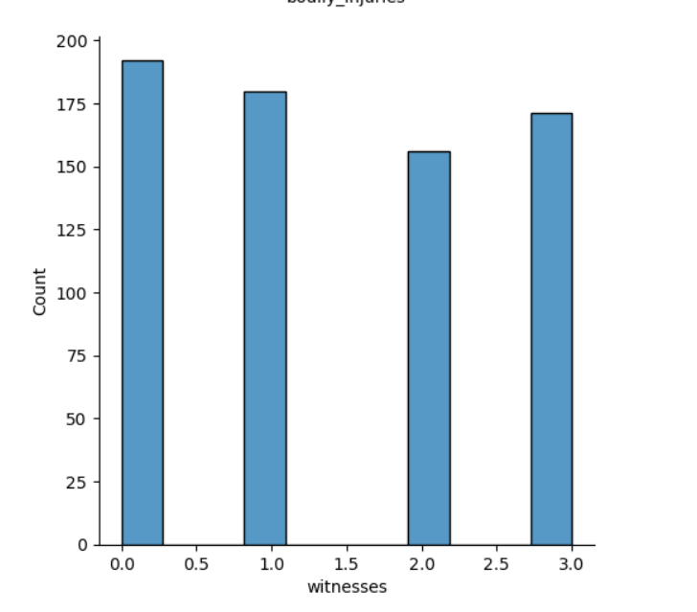
Number Of Witnesses gives some information
Even the presence of one witness increase the chances of detecting a claim as fraudulent.
Out of 247 fraudulent claims, 197 claims had atleast one witness present

Slide 12
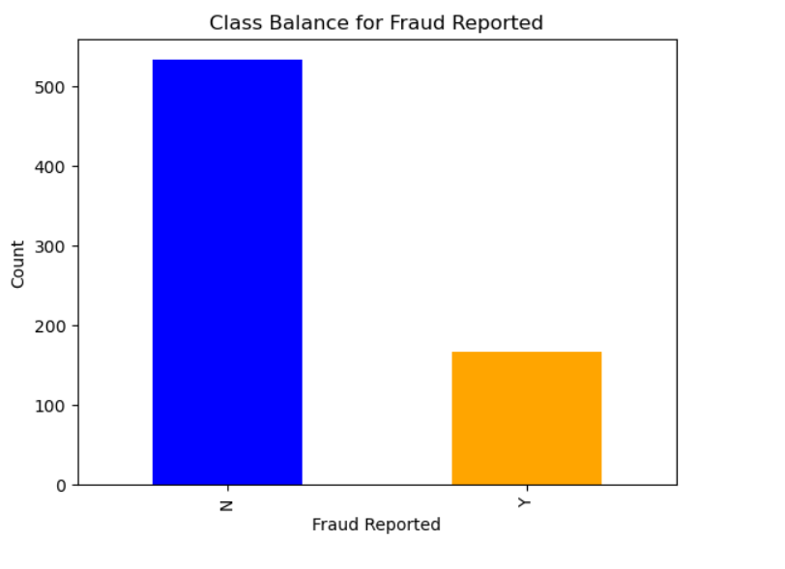
Fraud Report
Availability of police report reduces the chances of fraudulent claims, although fewer cases actually have a police report available.
Increase in number of datapoints would help to determine a more clear relationship between fraudulent claims and the availability of police reports.

Slide 13
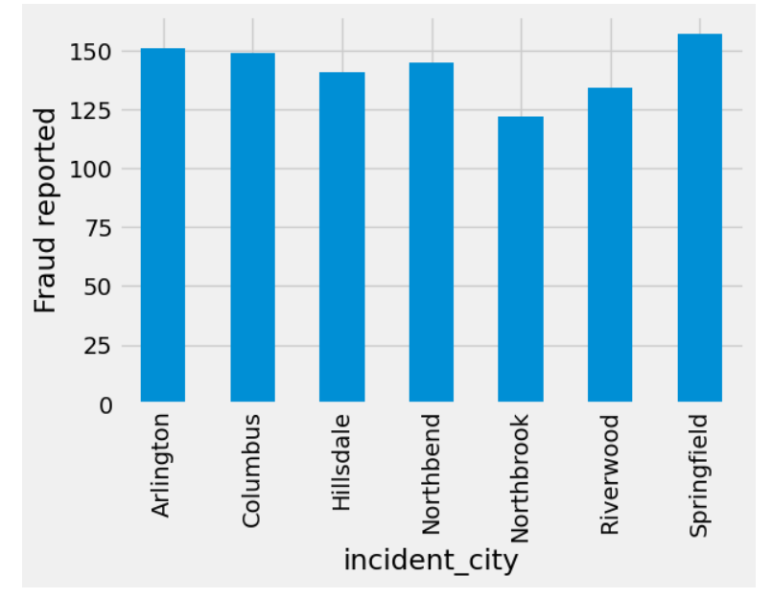
Fraud Report By City
Springfield Contains 155 %

Slide 14
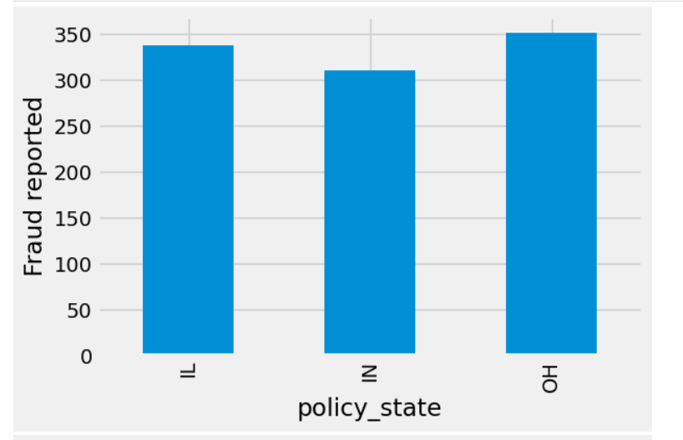
Fraud Report By State

Slide 15
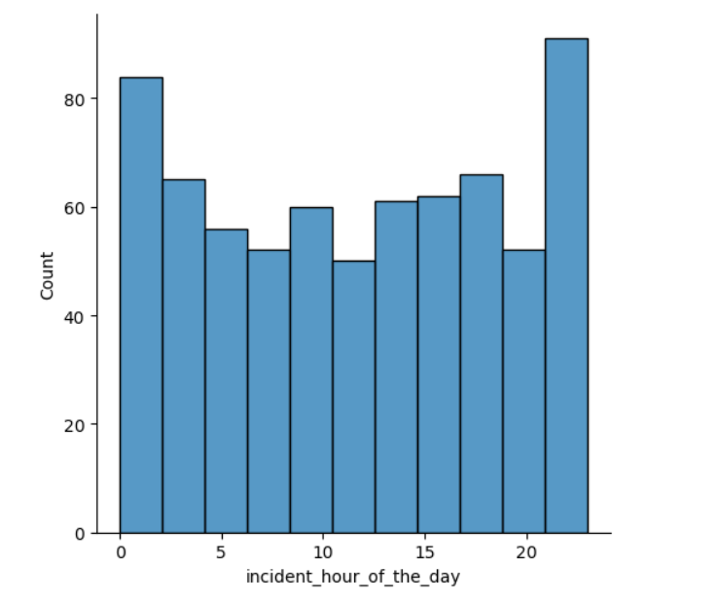
Incident hour of the day
Major Damage is reported fraudulently more often.
This is what would be expected.
People claiming for minor damage tend to add other previous damages that would not actually be part of the incident for which the claim has been made

Slide 16
Feature Selection

Slide 17
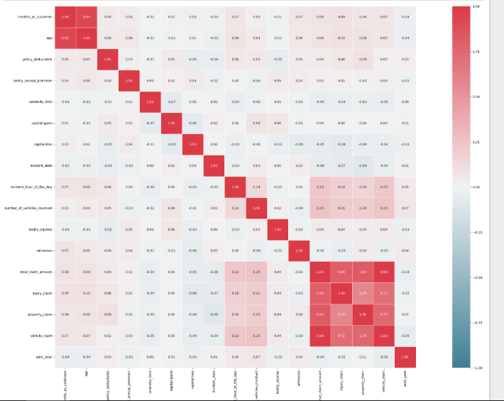
Correlation Amongst Numerical Features
The following heatmap shows high correlation amongst the following columns:
Age and Months as customer Total Claim Amount with its individual constituents. (Injury, Property, Vehicle)
Age and the individual Constituents were dropped from the dataset.

Slide 18
Models and Approaches

Slide 19
Models Used
After removing correlated features and features with unique values, we have 30 features in the dataset:
9 Numerical Features
21 Categorical Features
Predictive Model used is RandomForestClassifier and XGBoostClassifier
Also tried using GradientBoostingClassifier, however above models gave superior performance
RandomForestClassifier gave best performance, so results for that have been shown.

Slide 20
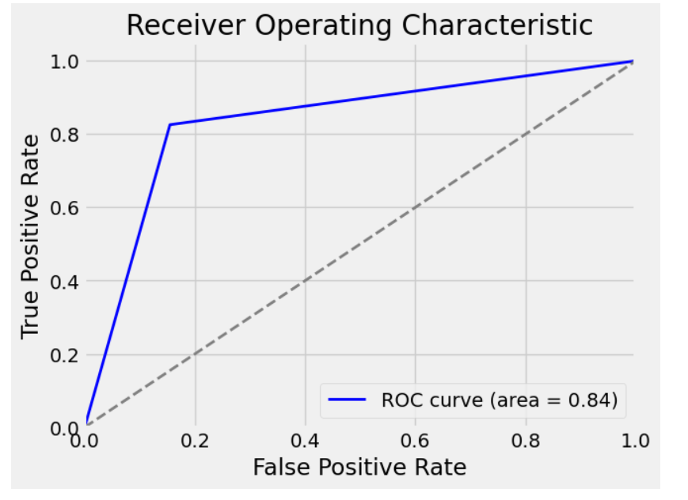
ROC AUC Curve
ROC AUC Curve shows how well the model has been able to separate out the classes
ROC AUC Score of 0.84 shows the model has done a good job, but there is room for improvement.

Slide 21
Conclusion
The goal was to detect fraudulent claims,Recall is a good parameter. the summary of logistic regression model and random forest model are below:
Logistic Regression model:- Training Data Accuracy :- 83.5% sensitivity: 82.5% specificity: 84.5% precision: 84% Recall: 82.5% F1-Score: 83.2%
(Validation Data) Accuracy :- 83.6% sensitivity: 80.4% specificity: 86.7% precision: 86.4% Recall: 80.4% F1-Score: 83.3% Summary: The fraud is associated with hobbies of chess and cross-fit. It is negatively assosicated with minor damages, total loss. Also, Wrangler owners are good.

Slide 22
Random Forest model:- (Train Data) Accuracy :- 92.3% sensitivity: 96.3% specificity: 88%precision: 89% Recall: 96% F1-Score: 92%
(Validation Data) Accuracy :- 82.7% sensitivity: 78.6% specificity: 86.9% precision: 86.1% Recall: 78.6% F1-Score: 82.2% Summary: Again fraud is associated with hobbies of Chess and cross-fit. similar to Logistic regression it also says the claim is negatively associated with minor damage and Total loss. Random forest also asks us to put weight around parameters like vehicle/injury/property claim, a new customer and a loss ratio high.

Slide 23
Insights and Business Decisions
Claims to be targeted:
Having atleast one witness
Insured has a hobby of Chess or CrossFit
Insureds listing their occupation as Exec- Managers
Insureds reporting claims for major damage
Claim amount and insured education level are also important features as evidenced by model feature importance
There is also a need to increase police reports on claims made as it can serve as an initial screen for fraudulent claims
Also prepared an interactive Dashboard using Dash and plotly showing the Countplots for categorical features

Slide 24
Future Steps
Time permitting, following additional actions could have been taken:
Use of different imputers for missing values to see if any other gives superior performance such as iterative imputer
Use of different models like LogisticRegression and SVM to see how dataset responds to these models
Identify unique set of features that might always be leading to fraudulent claims.
Adding features to dashboard and make it more user-friendly
There is a need to capture more data as not many useful business insights can be drawn from 1000 datapoints. More data, better results

Slide 25
GitHub Link

